Slide 1
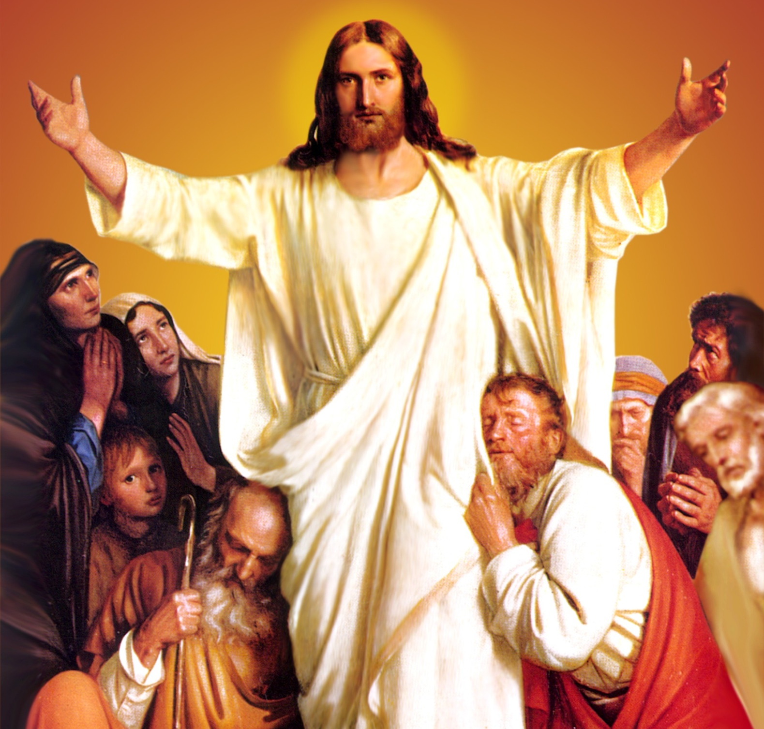
CATECHETICAL TEXTBOOK SERIES OF THE SYRO - MALABAR CHURCH
ON THE PATH OF SALVATION - 6
PEOPLE WHO
EXPERIENCED JESUS
6

Slide 2
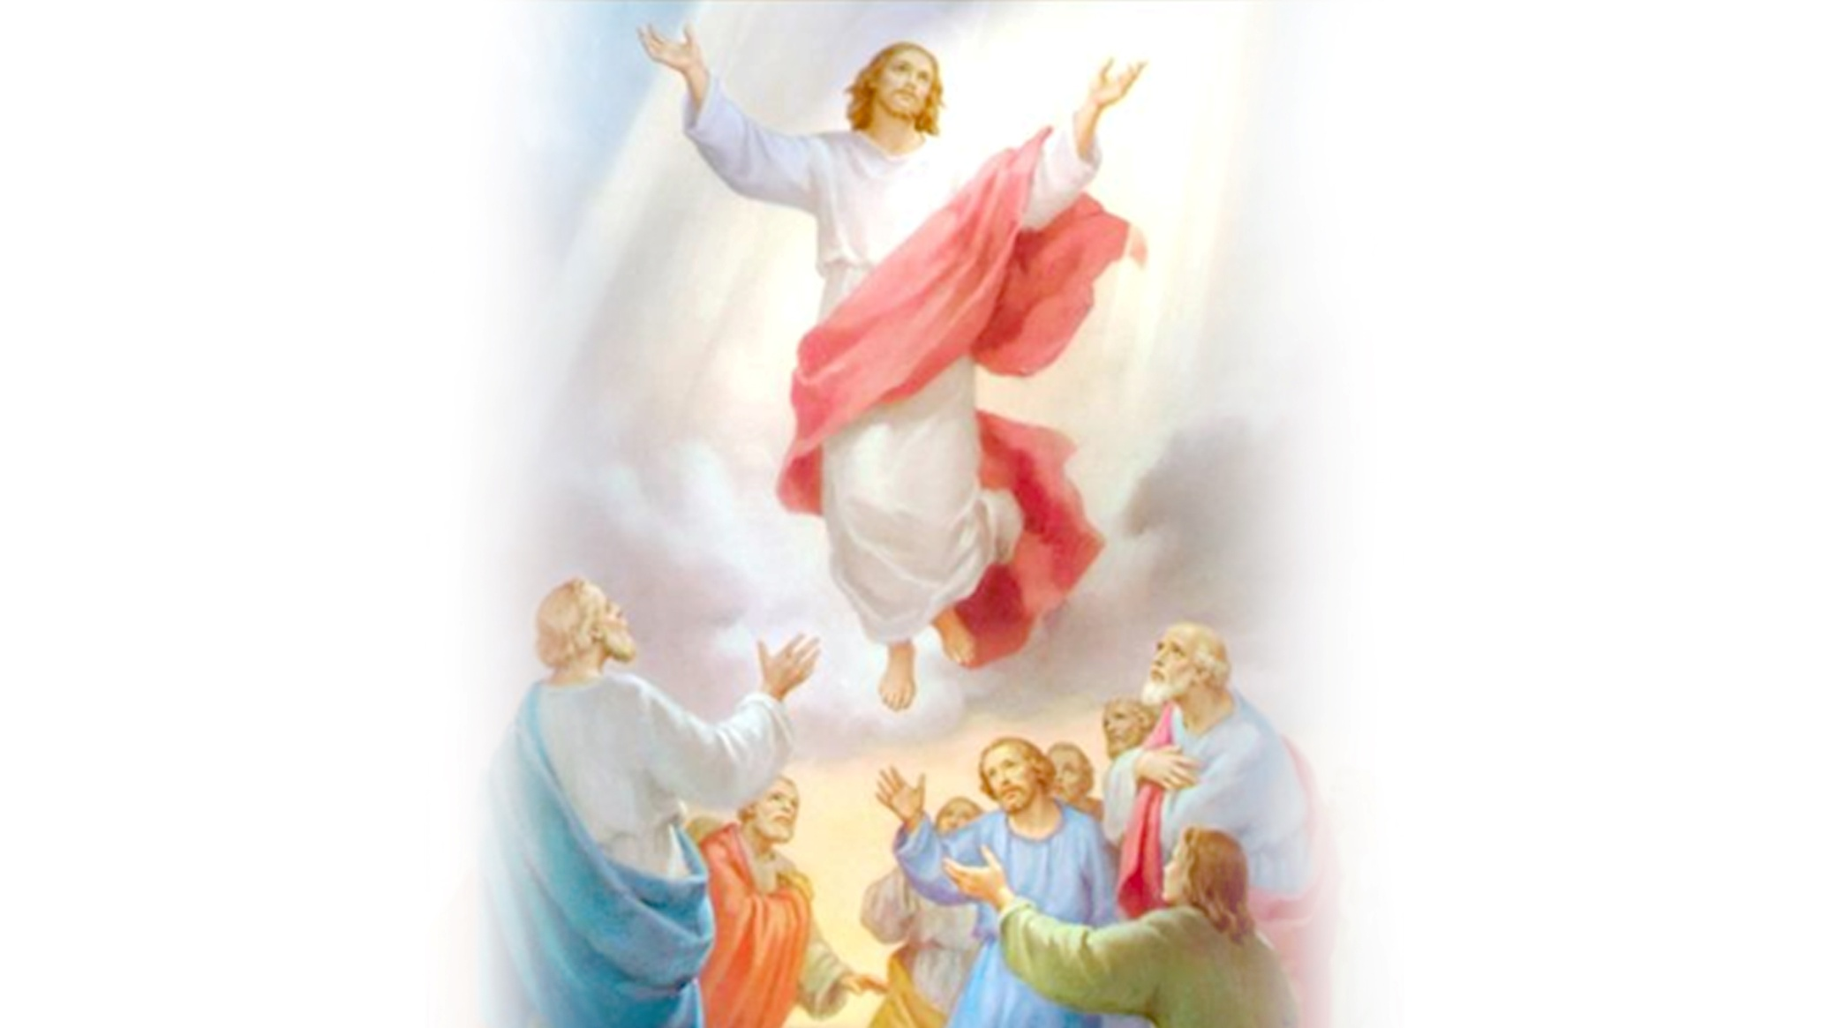
LESSON 13
ASCENSION AND THE MISSION OF EVANGELIZATION

Slide 3
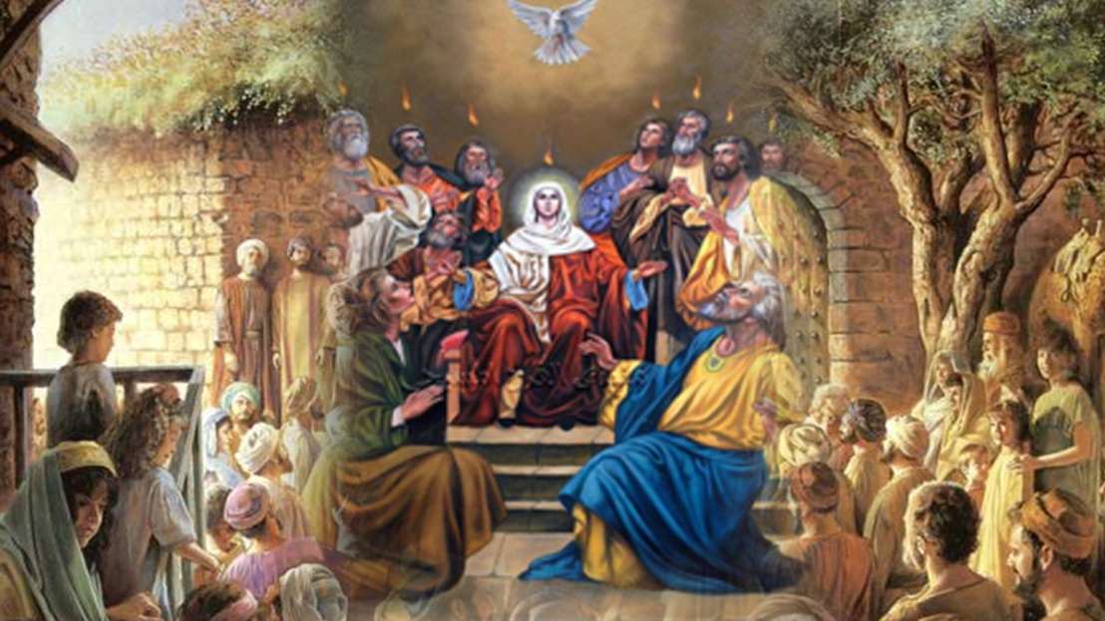
For fourty days after the resurrection Jesus used to appear among the disciples and teach them regarding the kingdom of God. He gave them enough proof and appeared before them as a person who is alive. On the fortieth day Jesus took them to Bethany. When they gathered there they asked him, “Lord is this the time when you will restore the kingdom to Israel?” He replies, “It is not for you to know the times or periods that the Father has set by his own authority. But you will receive power when the Holy Spirit has come upon you; and you will be my witness in Jerusalem, in all Judea and Samaria, and to the ends of the earth.”

Slide 4
Saying this he raised his hands and blessed them. Even as they were watching, he was lifted up, and a cloud took him out of sight. While they were gazing towards heaven, watching him go up, two men in white robes stood by them. They said, “Men of Galilee, why do you stand looking up towards heaven? This Jesus who had been taken up from you into heaven, will come in the same way as you saw him go into heaven” (Acts 1: 6- 11).
Filled with great joy, they returned to Jerusalem. They spent all their time in praising the Lord in the temple. Jesus had earlier ordered them not to leave Jerusalem, but wait there for the promise of the Father. He said, “This is what you have heard from me; for John baptized with water, but you will be baptized with the Holy Spirit not many days from now” (Acts 1: 4- 5).

Slide 5
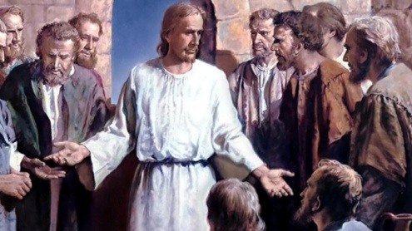
MISSION OF EVANGELIZATION
The Eleven disciples went to Galilee, to the mountain to which Jesus had directed them. When they saw him, they worshipped him; but some doubted. And Jesus came and said to them, “All authority in heaven and on earth has been given to me. Go therefore and make disciples of all nations, baptizing them in the name of the Father, and of the Son and of the Holy Spirit, and teaching them to obey everything that I have commanded you. And remember, I am with you always, to the end of the age” (Mt. 28: 16- 20). Before his ascension Jesus entrusted the disciples with a mission. The assignment that Jesus gave to the disciples was to take to the ends of the world the good news of salvation for the whole world. The chief task of the church is 'teaching'. Those who believe in the Good News must be absorbed into Jesus, and must be led into the fullness of Christian faith. That repentance for the forgiveness of sins must be preached over the whole world and that good news of salvation must be spread are the missionary assignments of the disciples.

Slide 6
SEASON OF APOSTLES (SLEEHAKKALAM)
This is the sixth season of the liturgical year. This period starts with the feast of Pentecost. This time reminds us of the disciples, filled with the Holy Spirit, traveling all over the world with the message of the gospel, and building the foundations of the church communities. The important mysteries that we reflect on during this apostolic season are: The works of the Holy Spirit, the strong relationship between the apostles and the Church, the sublime grace of the early Church, and the missionary nature of the Church.
The first Friday of the apostolic season is known as the golden Friday. This name has its origin in the healing of the cripple by Peter when he was going to the temple with John. When the lame man asked for some alms, Peter said, “I have no gold or silver, but what I have I give you; in the name of Jesus Christ of Nazareth, stand up and walk” (Acts 3: 6). He was healed by these words of Peter. The golden Friday reminds us of this incident.

Slide 7
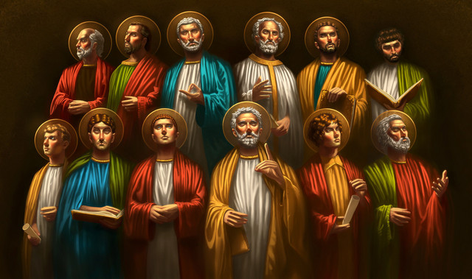
12 APOSTLES

Slide 8
THE FEAST OF PENTECOST
On the tenth day after the ascension of Jesus, the Holy Spirit came upon the disciples in the form of tongues of fire. This is commemorated on the feast of Pentecost. This is considered to be the day of the official opening of the Church. In Pentecost is the memory of the Holy Spirit being sent to live in the Church and to lead the Church. This feast helps the Church and the children of the Church to be filled with the Holy Spirit.

Slide 9
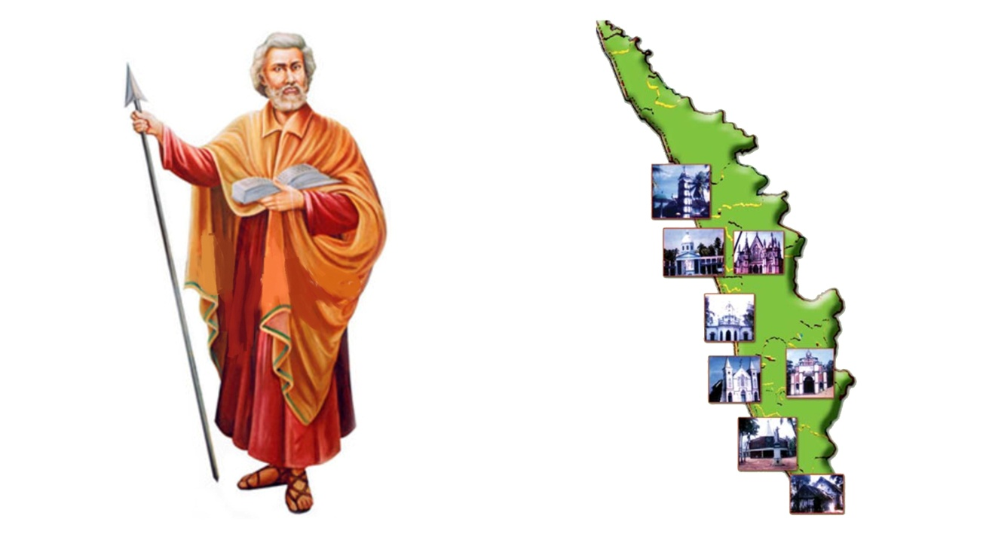
TO THE ENDS OF THE EARTH
As Jesus had directed them, the disciples stayed in Jerusalem till they received power from above. After receiving the Holy Spirit on the Pentecost, the disciples set out to proclaim the good news the gospel. As St. Thomas came to India with the gospel of Jesus, the other disciples set out with great zeal to take the Word of God to the ends of the earth. Though not one of the twelve, St Paul, whom Jesus had chosen, was the most zealous evangelist of the early Church.

Slide 10

ACTS OF THE APOSTLES
The fifth book of the New Testament is the Acts of the Apostles. This book describes how, filled with the Holy Spirit, the community of the disciples and the early church, made their lives witness to the gospel. Here we see a community led by the Holy Spirit. Therefore this book is called the gospel of the Holy Spirit.

Slide 11
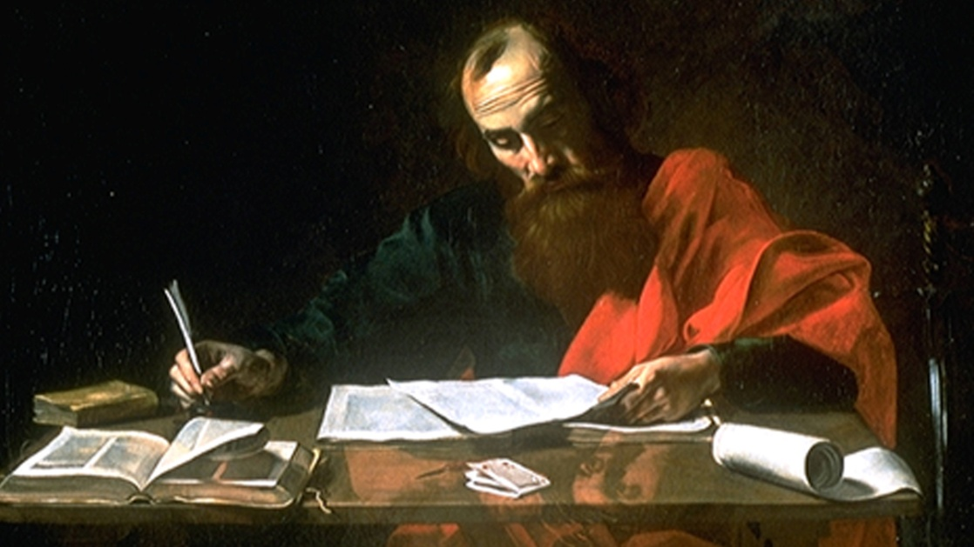
EPISTLES OR LETTERS
After the Acts of the Apostles, as part of the growth process of the early Church, there are 21 letters or Epistles in the New Testament. Among these, 14 are known in the name of St. Paul. The seven letters that follow these are called 'universal letters' because they are not addressed to a certain Church or individual, but for the universal Church. The authors of these letters are; James, Peter, John and Jude (Juda Thadeus). There are two letters from Peter and three from John. These letters give guidelines for a fruitful life of faith.

Slide 12
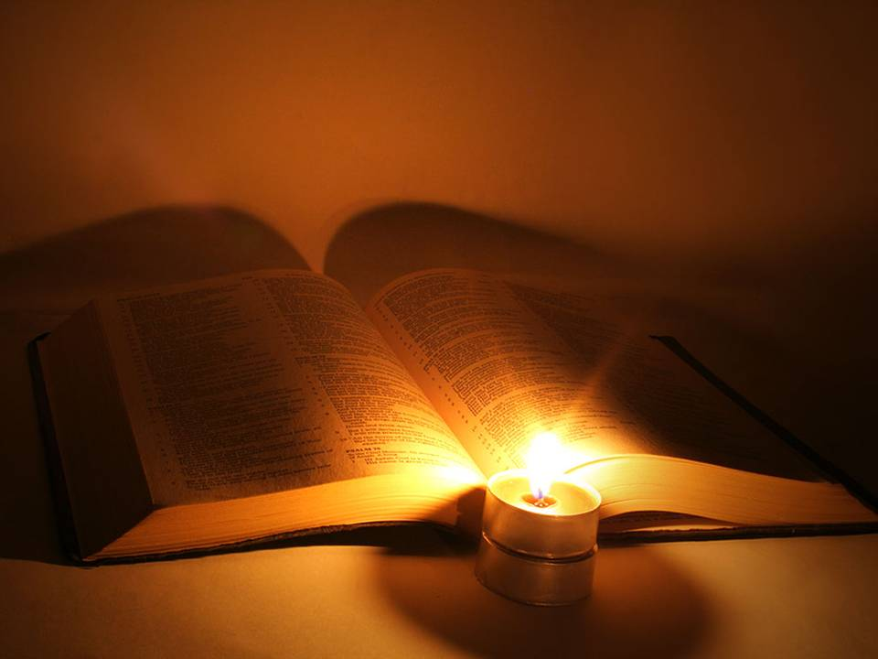
EACH CHRISTIAN A MISSIONARY
The disciples used their knowledge and skill totally to make the world know Jesus whom they knew and experienced. They even sacrificed their lives for this end. Still, the mission to take the gospel to the ends of the earth is not yet complete. This mission is to continue through each baptized disciple of Christ. When we receive baptism in the name of the Father and of the Son and of the Holy Spirit, He entrusts us with this important task.
The goal of the message of the gospel is the eternal salvation of man. This, we get through Jesus Christ. 'There is no other name under heaven given among mortals by which we must be saved” (Acts 4: 12). Therefore we must proclaim clearly that Jesus is the Lord. The strongest gospel proclamation is the example of our lives.

Slide 13
Let us pray
O! Jesus, who appointed apostles to proclaim the Gospel and promised your presence with them, bless us to witness to you in our lives.

Slide 14
Read the word of god:
Luke 24:50-53

Slide 15

WORD OF GOD FOR GUIDANCE
"Go into the world and proclaim the good news
to the whole creation."(Mk 16:15)

Slide 16
LET US DO:
Read chapters 8 and 9 of the Act of the Apostles and explain the conversion story of St. Paul.

Slide 17
MY DECISION
I will talk about Jesus whenever I get a chance.

Slide 18
LET US Find out the answer
1. What was the answer given by Jesus when his disciples asked: "Lord, is this the time when you will restore the kingdom to Israel"?
2. What was the mission undertaken by the disciples?
4. What are the important mysteries that we commemorate during the Season of Apostles?
5. What is the basic objective of the Gospel message?

Slide 19
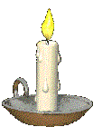


Thank you

